Slide 1
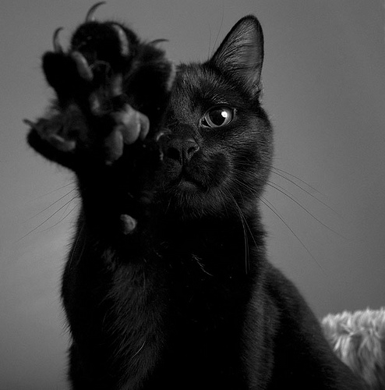
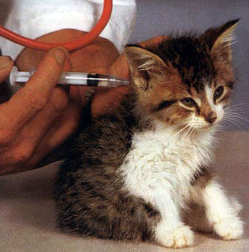
Feline Leukemia Virus
Aaron Briscoe
All About

Slide 2
Etiology (Cause)
Feline Leukemia Virus or FeLV is caused by a
retrovirus.
A retrovirus is an RNA virus that
uses the enzyme reverse transcriptase to
encode its RNA into the DNA of the host cell,
allowing the retrovirus to take over that cell.

Slide 3

Disease History
FeLV was first documented in domestic cats in
the 1960’s.
Since then it has been
discovered in many big cats,
but the virus seems to be
benign and rarely
causes evident signs .

Slide 4
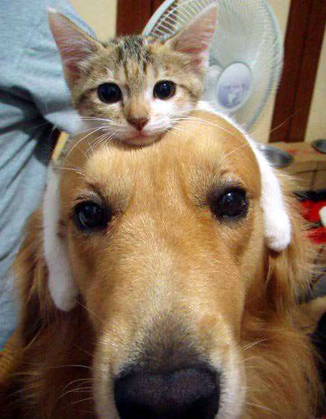
Signalment (Who gets FeLV?)
“It appears that cats are the only species susceptible to infection with FeLV, [though] kittens are at [a] significantly higher
risk for contracting the disease than adult cats.”

Slide 5
Transmission
FeLV is unstable in the environment, requiring close, prolonged contact between cats for transmission to occur.
The virus is most commonly spread through saliva, tears, urine, and milk. Can also be spread through fighting, grooming, or exposure to contaminated food and water bowls, or litter pans.

Slide 6
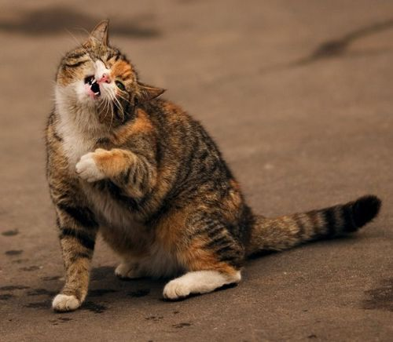
Clinical Signs
Cats that are exposed to FeLV may develop
Anemia
Anorexia
Depression
Weight loss
Nervous system diseases
Secondary infections

Slide 7
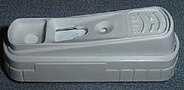
Diagnostic tests
Some tests that would be run in order to diagnose a client with FeLV.
FeLV positive on ELISA test
CBC: nonregenerative anemia
IFA (indirect
immunofluorescent antibody assay): positive
Clinical signs of recurring infections

Slide 8
Treatment
To help get your FeLV+ patient healthy and keep him healthy the client should keep him indoors and away from all other cats. He should also be kept him up to date on all vaccinations and any stress should be eliminated

Slide 9

Pathological Lesions
No known pathological lesions.

Slide 10
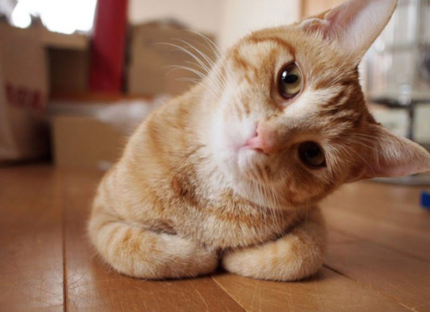
Prognosis
The prognosis for FeLV+
patients depends on the
immune system of the cat,
the level of exposure to the
virus, and its vaccination
history. Disease caused by
FeLV is very serious, and it is
estimated that fewer than
20 percent of persistently
infected cats will survive
more than three years.

Slide 11
Prevention
Before bringing a new kitten or cat into your home, it is essential to have it tested for FeLV so as not to spread the virus to any previous resident cat’s.
Also get all cats vaccinated and keep cats away from all known infected cats.

Slide 12
Client Education
Clients need to know and understand a few things about FeLV+ cats.
A healthy FeLV-positive cat DOES NOT need to euthanized .
The client should continue to:
Keep the cat inside
Keep isolated from other cats
Keep up with vaccinations
Take the cat to the vet if any sign of disease develops

Slide 13
References
Common Diseases of Companion Animals pgs.231-232
http://www.merckvetmanual.com/mvm/index.jsp?cfile=htm/bc/57000.htm&word=feline%2cleukemia
http://www.onlynaturalpet.com/KnowledgeBase/knowledgebasedetail.aspx?articleid=134
http://members.petfinder.com/~MA199/resourcePages/felineHealth/FeLV.pdf
http://www.drsfostersmith.com/pic/article.cfm?aid=2175

